Slide 1
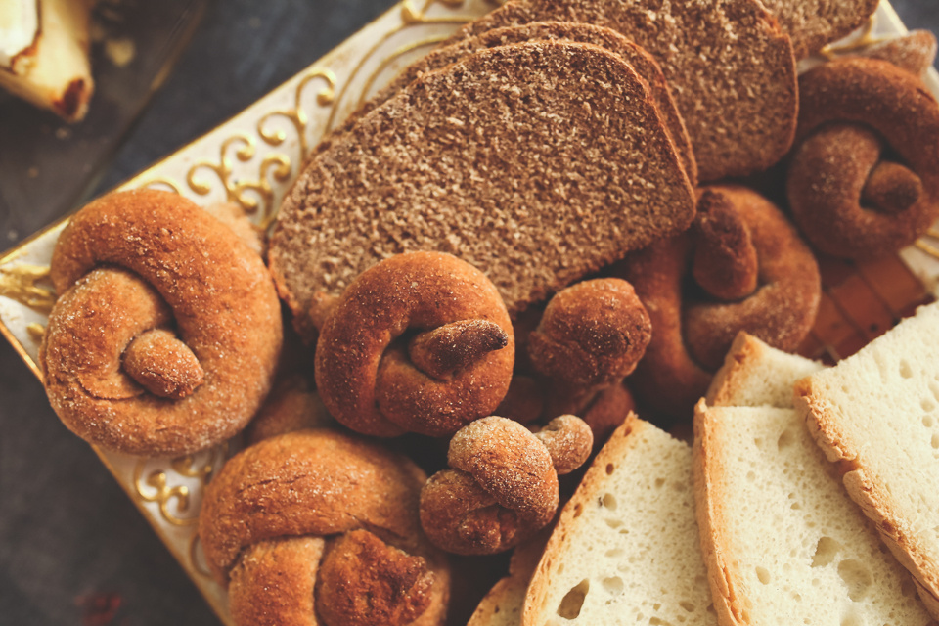
Bakery Sales
Analytics
PRESENTED BY AKHMAD MASYUDI

Slide 2

Context
We live in the era of e-commerce and digital marketing. We have even small scale businesses going online as the opportunities are endless. Since a huge chunk of the people who have access to internet is switching to online shopping, large retailers are actively searching for ways to increase their profit. Market Basket analysis is one such key techniques used by large retailers to increase sales by understanding the customer's purchasing behavior & patterns. Market basket analysis examines collections of items to find relationships between items that go together within the business context.

Slide 3


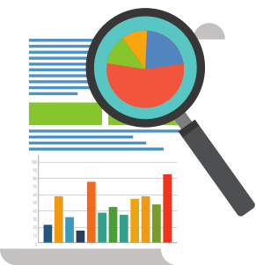

Content
The dataset belongs to "The Bread Basket" a bakery located in Edinburgh.
The dataset provide the transaction details of customers who ordered different items from this bakery online during the time period from 26-01-11 to 27-12-03.
Initially the columns in this dataset were TransactionNo, Items, DateTime, Daypart, and DayTime. After the data cleaning process, Quantity column was added.
The dataset has 20507 entries, over 9000 transactions, and 4 columns.

Slide 4
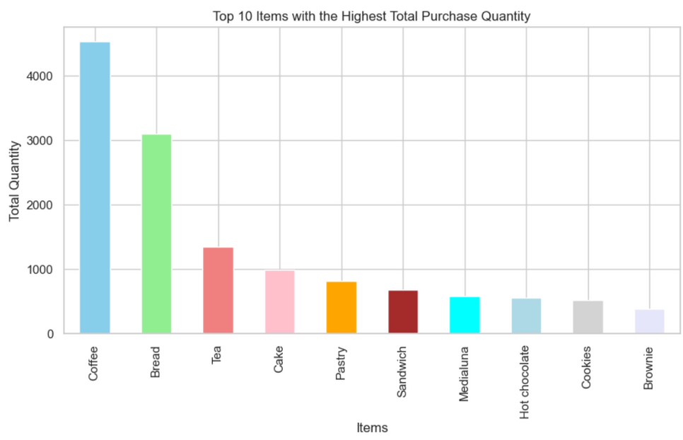

Insight
Based on insight about the Top 10 Items with the Highest Total Purchase Quantity, which is dominated by coffee products as the highest, recommendations can be focused on marketing strategies and stock management.
First, emphasis can be placed on special promotions and discount offers for coffee products to strengthen their presence as superior products. In addition, it is necessary to monitor stock carefully to ensure adequate availability, anticipate high demand, and minimize the risk of running out of inventory.

Slide 5
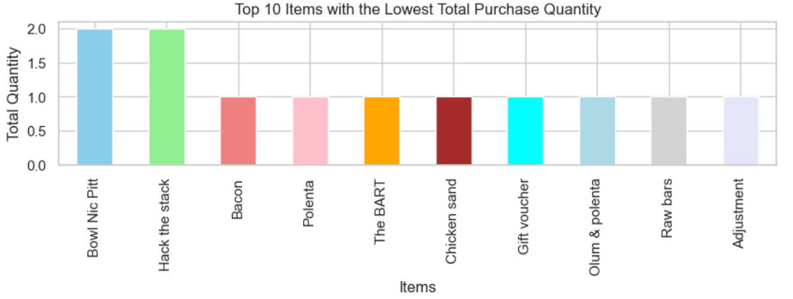
Insight
From the insight about the Top 10 Items with the Lowest Total Purchase Quantity, it is recommended to carry out a thorough analysis of these products to identify the causes of low purchase quantity.
Creative marketing strategies and price adjustments may be needed to increase the appeal of these products. Evaluation of quality, branding, and competitiveness relative to similar products on the market can help in understanding the factors that influence underperformance.
Additionally, engaging with customers through surveys or feedback can provide valuable insights to improve or enhance products, increase customer satisfaction, and increase the quantity of future purchases.

Slide 6
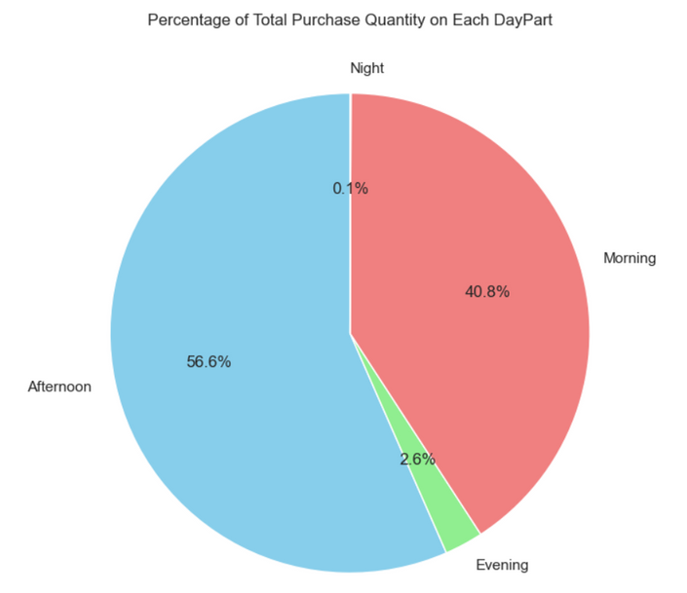
Insight
Based on insight into the sales percentage, the ranking from the highest is in the afternoon, followed by morning, evening and night, indicating that peak sales occur during the day. Recommendations can focus on optimizing marketing and stock preparation during daytime periods to maximize sales potential. It is also worth considering specific strategies to increase traction and sales in other periods, while understanding that night sales may be limited by shorter operating hours.

Slide 7
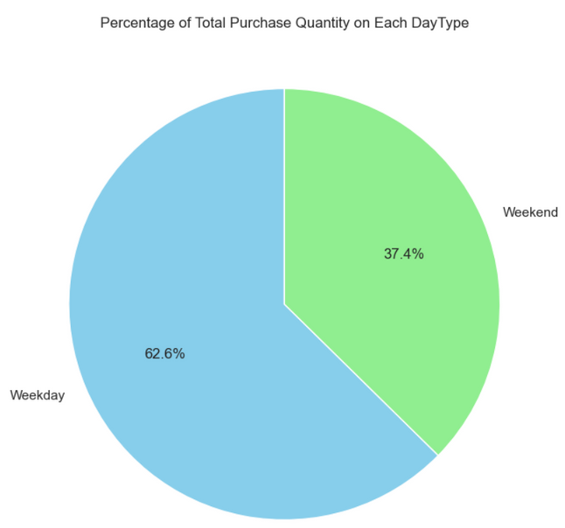
Insight
From insight into the weekly sales percentage, which shows the dominance of sales on weekdays, with weekday operating hours covering 5 days while weekends only 2 days, recommendations can be focused on optimizing sales potential during a limited time period. On weekdays, marketing strategies can be optimized during longer operating hours with special offers.
Meanwhile, on weekends, promotions and events need to be carried out to maximize the impact of these two operational days. Careful stock monitoring and daily trend analysis will be key to adapting strategies effectively, with possible collaboration with business partners or delivery services to expand customer coverage on weekends.

Slide 8
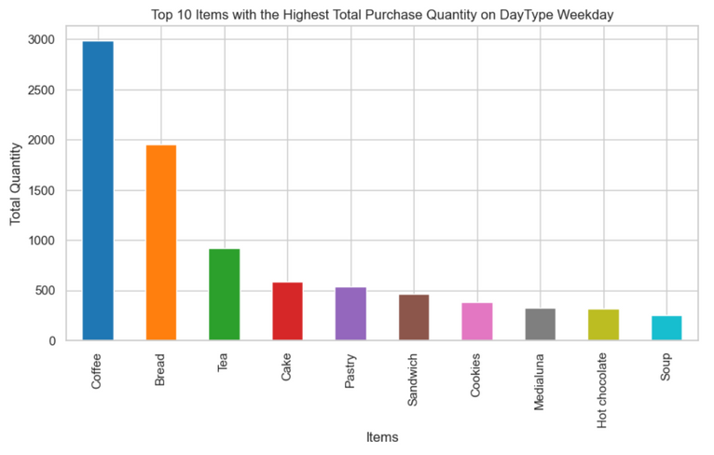
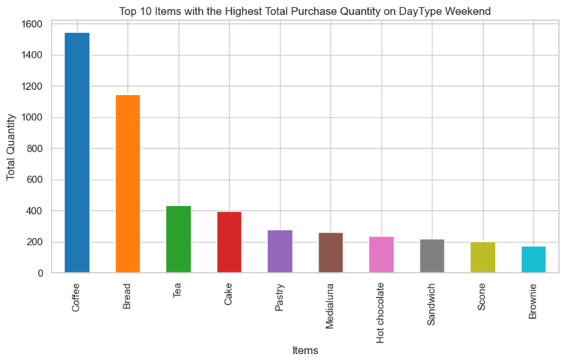
Insight
From the insight of the Top 10 items with the Highest Total Puchase Quantity during weekdays and weekends, with the same dominance in both, especially coffee, bread, tea and cake products, while the remaining 6 items are more varied, recommendations can be focused on developing marketing and promotional strategies to increase visibility these products.
In particular, for items that undersold during both periods, consider designing offer packages or increasing exposure through special promotions. Analysis of daily trends and customer preferences can help devise more targeted marketing strategies, while careful stock monitoring will ensure adequate availability. Increases in product diversification can also be explored to enrich offerings and meet various customer needs during weekdays and weekends.

Slide 9
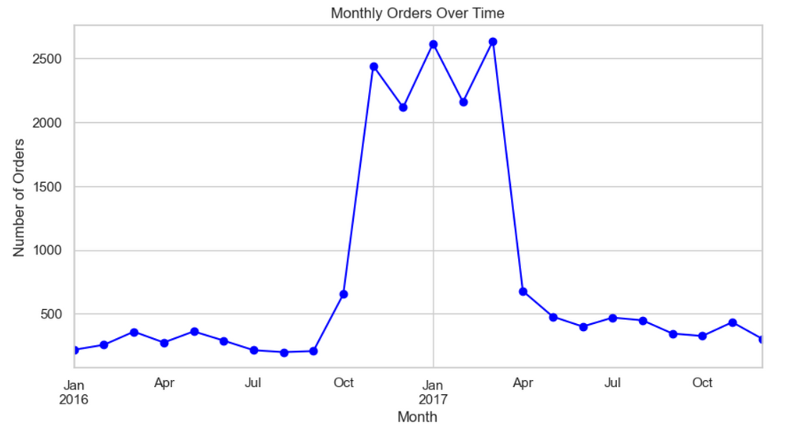
Insight
From insight regarding monthly orders with total orders experiencing a significant increase from November to March, recommendations can be focused on careful planning and preparation to face periods with high purchasing activity. Marketing strategies can be optimized by launching special promotional campaigns, discount offers or events in these months to maximize customer participation. Careful stock monitoring and increasing production capacity are also crucial aspects of ensuring product availability during demand spikes. Additionally, further analysis of the factors that may have triggered such increases can provide additional insights for refining strategies and adapting more effective marketing tactics.

Slide 10
Summary
THE RECOMMENDATIONS ARE CENTERED ON MARKETING STRATEGIES AND STOCK MANAGEMENT. FOR COFFEE PRODUCTS, THE EMPHASIS IS ON SPECIAL PROMOTIONS TO ENHANCE THEIR PRESENCE, ACCOMPANIED BY CAREFUL STOCK MONITORING.
FOR PRODUCTS WITH LOW PURCHASE QUANTITY, A THOROUGH ANALYSIS IS RECOMMENDED, INCORPORATING CREATIVE MARKETING STRATEGIES AND PRICE ADJUSTMENTS. ENGAGING WITH CUSTOMERS THROUGH SURVEYS IS ADVISED TO GAIN INSIGHTS FOR PRODUCT IMPROVEMENT.
THE SALES PERCENTAGE INSIGHT SUGGESTS OPTIMIZING MARKETING DURING PEAK DAYTIME PERIODS, WITH CONSIDERATIONS FOR OTHER TIMEFRAMES.
WEEKLY SALES DOMINANCE ON WEEKDAYS PROMPTS STRATEGIES FOR LONGER OPERATING HOURS AND COLLABORATIONS.
MONTHLY ORDER SPIKES FROM NOVEMBER TO MARCH CALL FOR CAREFUL PLANNING, STOCK MONITORING, AND FURTHER ANALYSIS FOR EFFECTIVE STRATEGIES.

